Slide 1

Julia for Data Analysis in Ecology and Evolution
GLOBE Institute

Slide 2
Who am I?
Michael Krabbe Borregaard
Associate Professor at Center for Macroecology, Evolution and Climate at University of Copenhagen
Working on Island Biogeography and Macroevolutionary patterns
Used Julia since 2015, developer of several Julia packages and owner of two Julia github organizations
Software Notes editor at Ecography

Slide 3
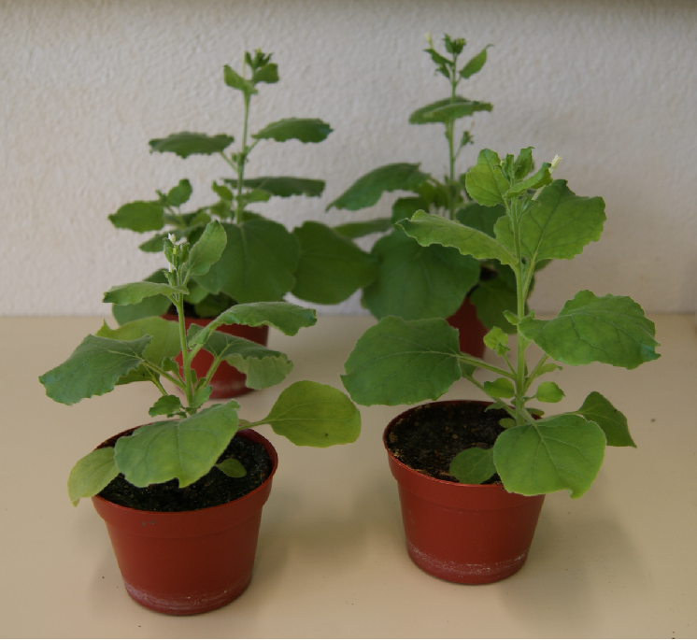

Who am I?
B.sc. in biology (right here!), master's in "Omics"
Lab work, genetic engineering / protein design in bacteria
PhD in bioinformatics
Developing tools (programs) for metagenomics, Vamb
Last 1.5 years: Post doc in DK's national influenza lab
Why are some influenzas more deadly and capable of infecting humans?
Research software engineer
Specialty: DNA bioinformatics / microbial genomics / molecular evolution
Been using Julia for ~4 years
Maintain BioJulia's: BioSymbols.jl, BioSequences.jl, FASTX.jl, Automa.jl
+ ~5 of my own Julia packages + my work code

Slide 4
Rafael Schouten

Slide 5
Goal and programme for today
Get you to feel comfortable working in Julia
Introduce the basic syntax and tooling
Cover some best practices for scientific computing with Julia
Introduce the first ecology packages

Slide 6
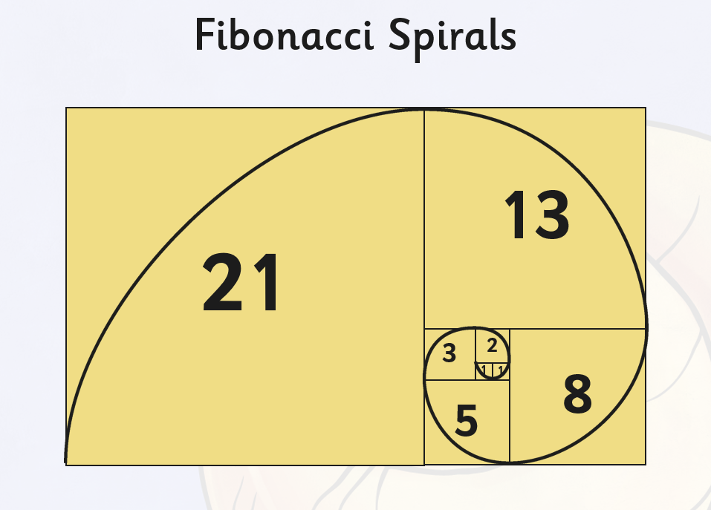
Quick Example
Calculate Fibonacci numbers

Slide 7
Why is julia fast? (how do computers work 1)
And why can it feel slow?
Julia and R are essentially different, one is compiled, the other interpreted
Compiled
C, C++, Fortran, Java, Julia
Interpreted
R, Python, Matlab

Slide 8
WSIWMTLAPLEIIIF
Or: "Why should I waste my precious time learning yet another faddish programming language, even if it is fast??"

Slide 9
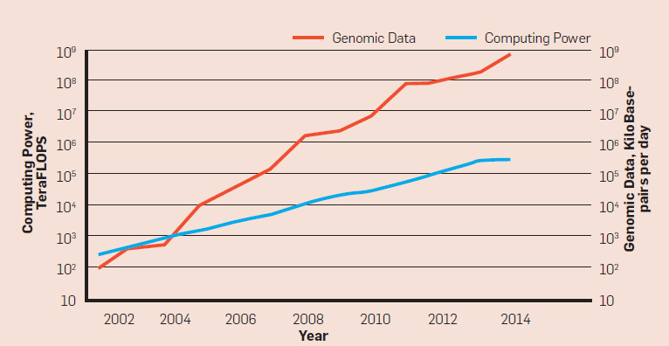

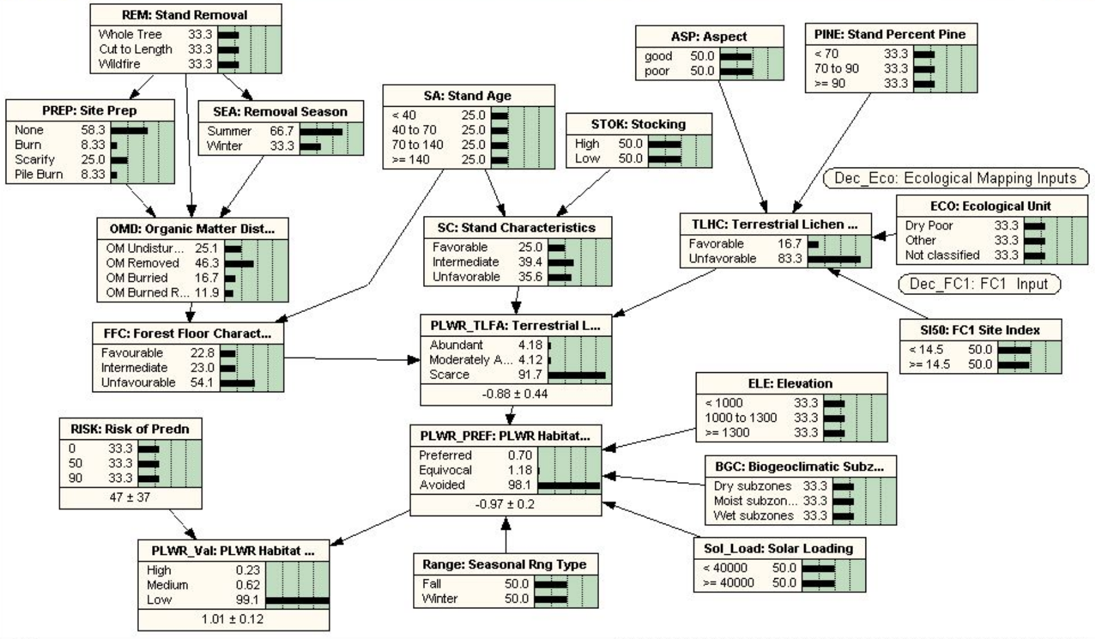
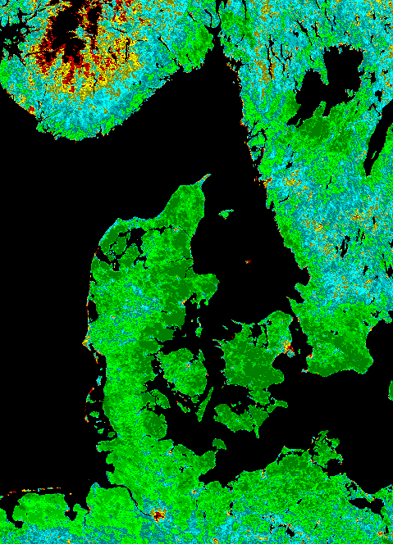
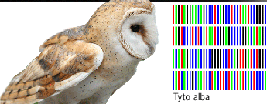
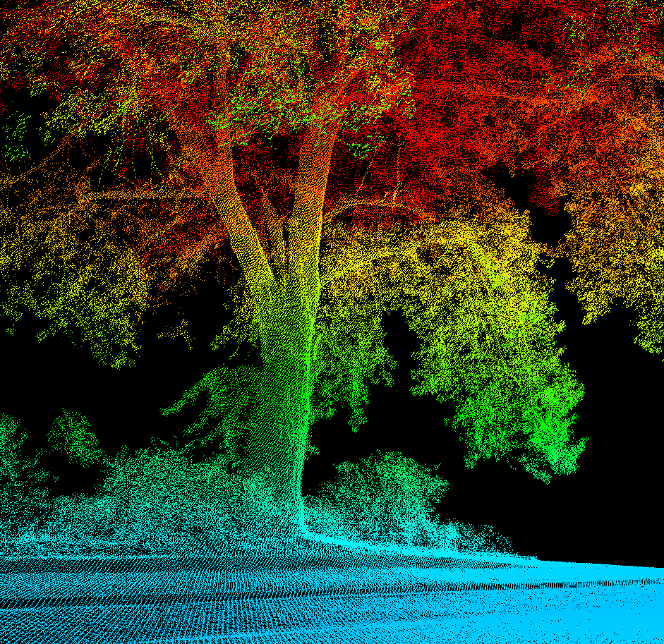
Berger et al. 2016, doi 10.1145/2957324

Slide 11
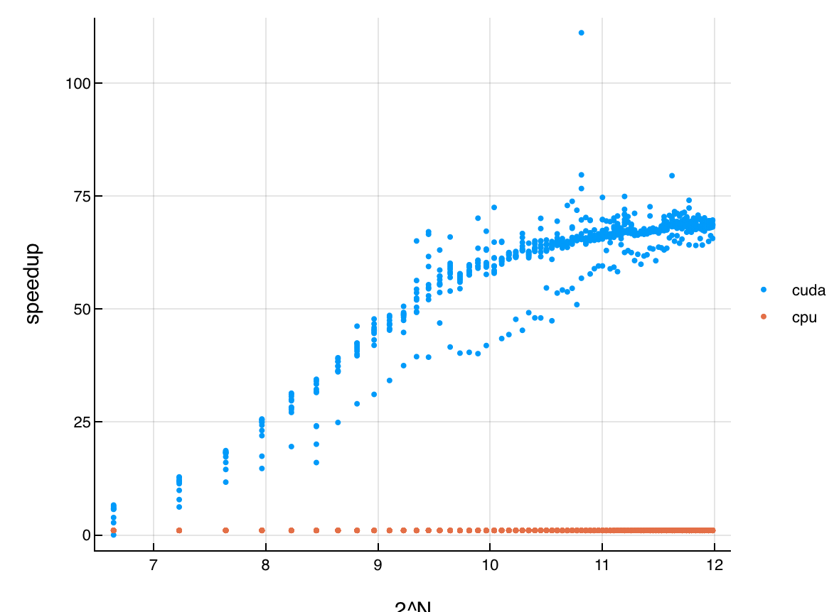
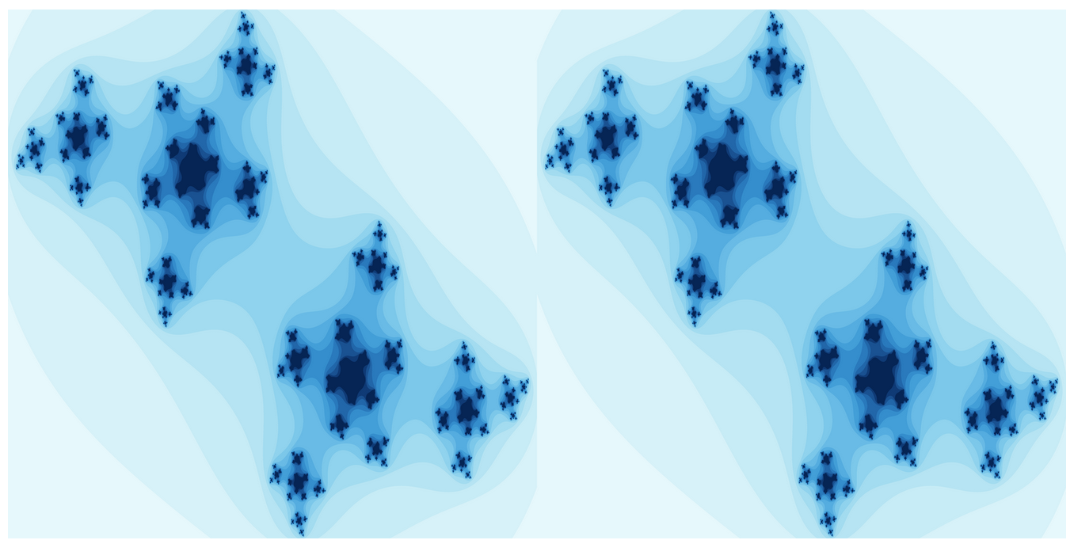
Parallel programming with Julia
Julia is built for advanced parallelism
Easy support for advanced multithreading with Threads.@threads
Julia makes it ”easy” to code on the GPU!

Slide 12
Is speed really that important?
Speed has a special status
A solution to the 2-language-problem
Does a package/library do exactly what you need?
Yes: Great!
Dunno: You need to read C/++ code.
No: You need to code in C/++.
Much easier to be a package author
Transparency and scientific reproducibility

Slide 13
Come for the speed – Stay for the multiple dispatch
The real thing that makes julia nice is that the language is constructed to make it very easy to extend other people’s code
That makes the package ecosystem modular, with lots and lots of code reuse
It’s easy to roll your own – usually goes fast – and quality of the final product is high
Combined with a culture of shared development and open source

Slide 14
Tooling
There are three main ways of interacting with Julia:
REPL/terminal (much nicer than R’s)
VSCode (RStudio-like IDE)
Pluto notebooks

Slide 15
Install Julia
Go to https://julialang.org/downloads/ and download the “upcoming release” (v 1.7.0-rc1)
Mac:
Download the “Intel or Rosetta” version
After install, add to PATH with this code from the [help] link
rm -f /usr/local/bin/julia
sudo ln -s /Applications/Julia-1.7.app/Contents/Resources/julia/bin/julia /usr/local/bin/Julia
Windows:
After install, follow the notes under [help] here: Adding Julia to PATH on Windows 10
Linux:
Don’t install from your package manager or snap, but use the generic linux binary
Symlink the binary to somewhere in your path
All: Open a terminal and type “julia” and make sure it works

Slide 16
Install VSCode
Install Visual Studio code from this link: https://code.visualstudio.com/download
Open it, choose view->extensions
Search for the “Julia” extension and open it
Restart
After opening, press ctrl (/cmd) + shift + p and type “Julia: Start REPL”
You’re flying
Then install git https://git-scm.com/downloads

Slide 17
Install Pluto
Open the package manager
]add Pluto
using Pluto
Pluto.run(run_notebook_on_load=false)
Go to your webbrowser and open a “new notebook”
Save it somewhere relevant

Slide 18
Shell modes
Julia has a number of “shell modes”, accessed by pressing a button
Most used are
“command” - for giving commands directly to the terminal – use with ;
“Pkg” – for adding and managing installed packages – use with ]
“help” – for searching the documentation of functions – use with ?

Slide 19
Exercise
Talk together for a few minutes, and identify the 3 functions from R you’d most like to know what is called in Julia
Preferably reasonably basic functions for programming – not some function to launch a machine learning framework
Answer on Socrative – room MACROECOLOGY

Slide 20
Basic types (how do computers work part 2)
How are things stored in a computer’s memory?
Integers
Floating point numbers stored very differently
Arrays of integers
Arrays of other things, like strings

Slide 21
Julia containers
The most commonly used containers in julia are
Arrays (vectors, matrices, higher dimensions)
Dictionarys (maps from a name (or any type of object) to an object)
Tuples (small vector-like things that cannot change – can have names)

Slide 22
The dot syntax
In Julia you cannot just use vectors as if they were single numbers
Instead there are lots of ways to work with containers
the awesome dot syntax
map
list comprehensions
generators
for loops and other loops
recursion

Slide 23
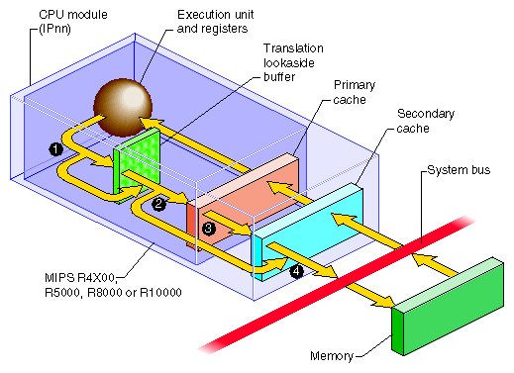
Being lazy - how does a computer spend time
Memory is much slower than computation
Especially for things allocated on the ”heap” rather than on the ”stack”
Many strategies in julia are designed to reduce memory access

Slide 24
Defining new functions
There are several ways to define functions - let's look at the
long-form,
short form
anonymous functions (-> form and do form)

Slide 25
Using anonymous functions
Many functions in Julia accept anonymous functions – this includes things like
count
findall, findfirst, findlast
sum, prod
filter, filter!

Slide 26
Bang (!) functions
Functions in Julia can sometimes modify their input arguments.
These functions are always clearly marked with a `!`

Slide 27
Splatting and slurping

Slide 28
User-defined types
The most important component of Julia is how easy it is for users to create new types, that are just as powerful as the inbuilt ones

Slide 29
Multiple dispatch
At home: see this video from one of the creators of the language
https://www.youtube.com/watch?v=kc9HwsxE1OY

Slide 30
Missing values / NAs
The missing value story is very different from that of R

Slide 31
Using macros
macros are a way of doing changes to source code

Slide 32
GIT assignment
Create a new project and environment
Initialize the repo and push it to github
Insert the Julia code you used to solve the dice example. Use two files, one that has the function, one that uses it in a script. Commit and push your change to github with a reasonable message.
On a new branch, edit the function with new functionality, e.g. added dice. Also write a docstring.
Commit and push to the new branch, then make a pull request and merge it.

Slide 33
Julia’s package ecosystem
Based on GitHUB
Very focused on modularity, reusability and interfaces
Collaboration between developers
Open source, MIT licence, much collaboration

Slide 34
Pkg – julia’s package manager
Starting up new projects
Environments make for reproducibilty
instantiate new environments etc

Slide 35
DataFrames and DataFramesMeta

Slide 36
Plotting
Julia has no ”base plotting” – all is provided by packages. These include
Plots – meta-syntax for several plotting packages and julia structs
PyPlot – Python’s wildly popular matplotlib used directly within Julia
Gadfly – a pure-julia implementation of Grammar of Graphics (GOG)
PlotlyJS – an offline interface to the javascript plotly library
GR – a really fast low-level plotting platform
PGFPlots(X) – plotting in LaTeX (for engineers)
VegaLite - a modern javascript implementation of GOG (ggplot2-style)
Makie – powerful plotting on the GPU with good 3D and interactivity
Bokeh, Winston, Vega, etc.

Slide 37
Plotting
Julia has no ”base plotting” – all is provided by packages. These include
Plots – meta-syntax for several plotting packages and julia structs
PyPlot – Python’s wildly popular matplotlib used directly within Julia
Gadfly – a pure-julia implementation of Grammar of Graphics (GOG)
PlotlyJS – an offline interface to the javascript plotly library
GR – a really fast low-level plotting platform
PGFPlots(X) – plotting in LaTeX (for engineers)
VegaLite - a modern javascript implementation of GOG (ggplot2-style)
Makie – powerful plotting on the GPU with good 3D and interactivity
Bokeh, Winston, Vega, etc.

Slide 38
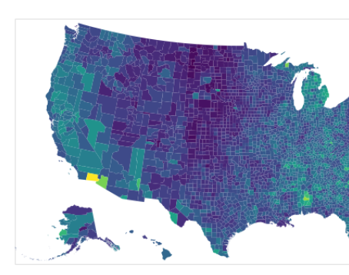
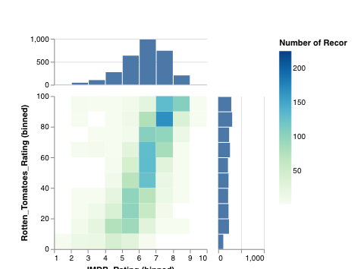
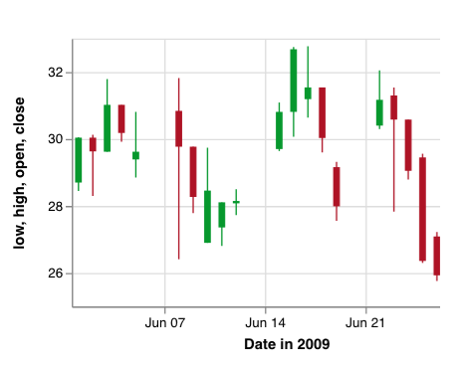
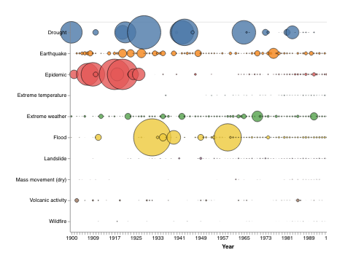
VegaLite
Very ambitious modern implementation of the grammar of graphics*
built by a large group at ... university
*grammar of graphics:
data are in dataframes
plot calls are declarative – you don’t draw, but associate data with aesthetics

Slide 39
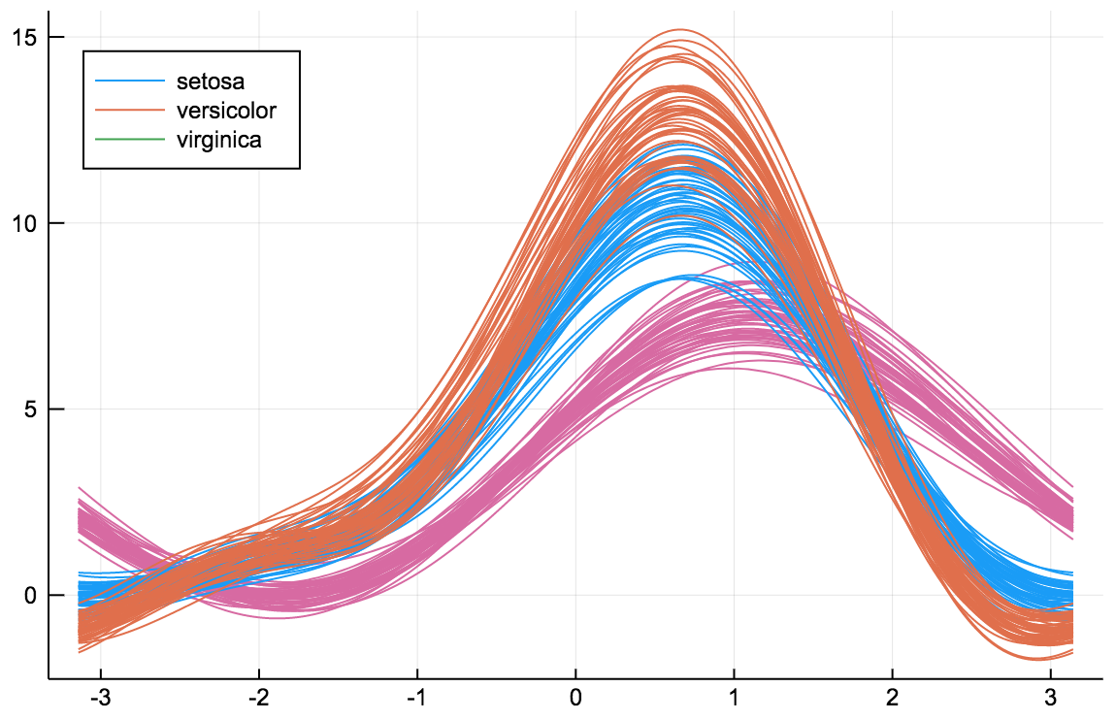
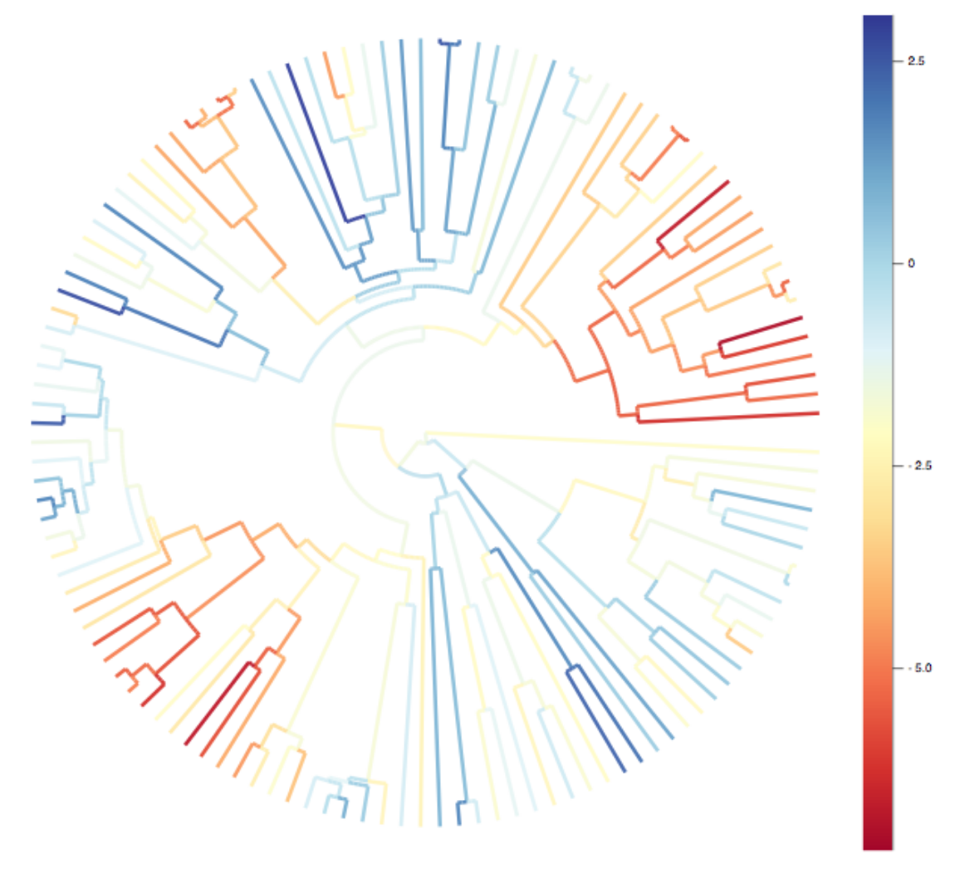
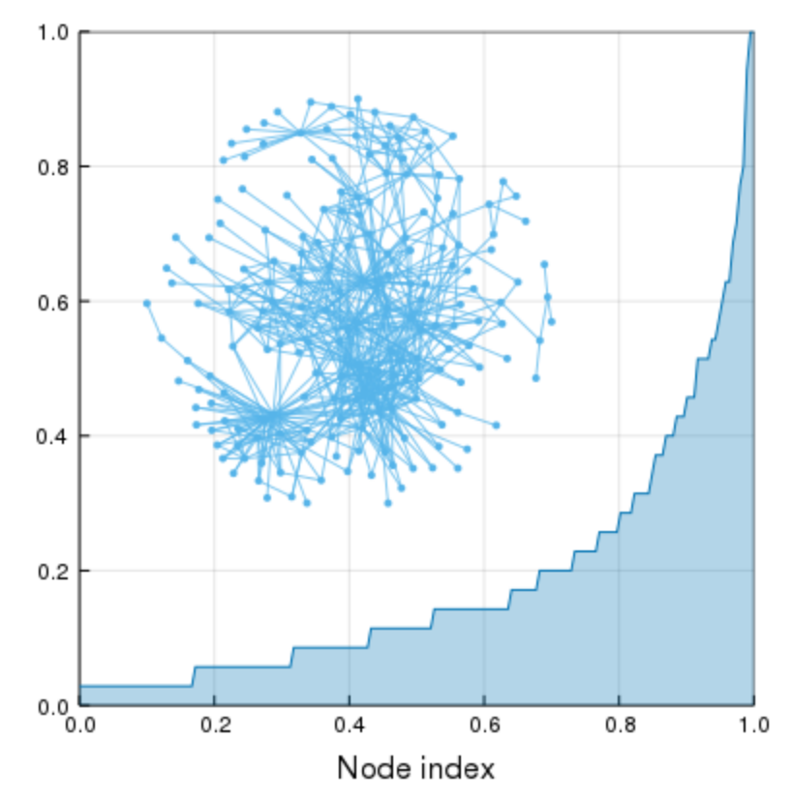
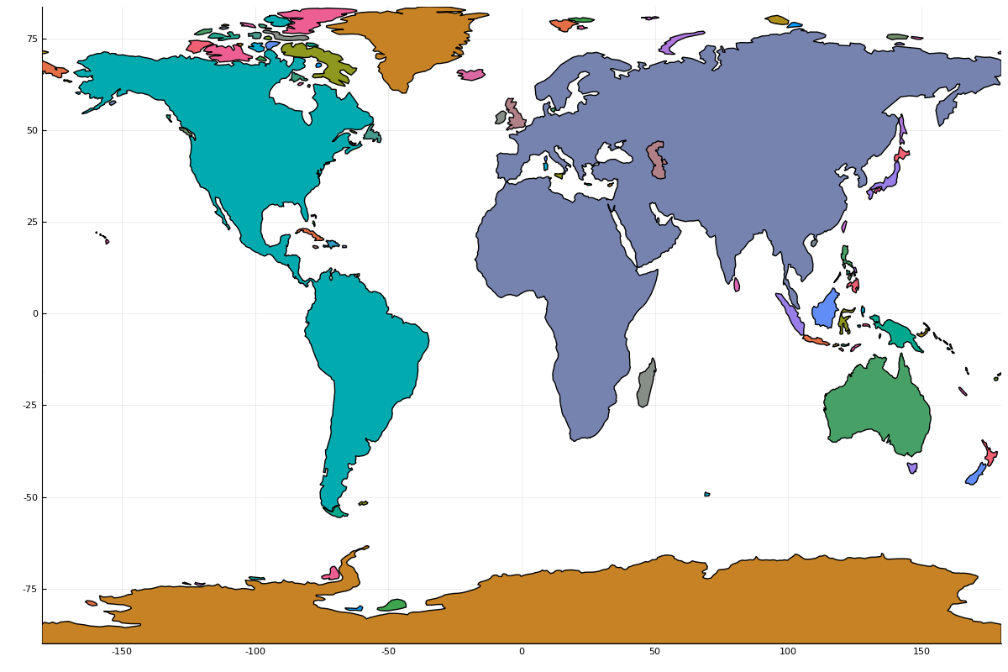
Plots
A package that creates a single syntax that can be used to plot with PyPlot, GR, PlotlyJS, PGFPlots, InspectDR
The most notable thing is ”recipes” that allow package authors to define plotting for their structs without depending on Plots
Used by SpatialEcology, Phylo, EcologicalNetworksPlots, MicroBiome, the Geo organisation, Turing (Bayesian analysis), DifferentialEquations

Slide 40

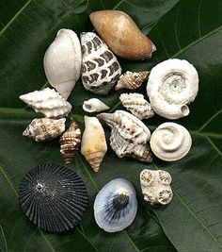
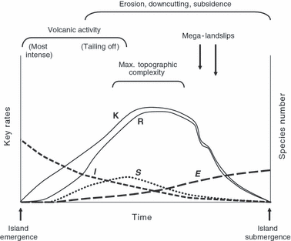




Linear and Mixed Models
Let’s investigate the global island occurrences of snails in the context of the General Dynamic Model of Island Biogeography

